Slide 1


Team 31:Chilly Dog
Bi-Weekly Update 1 Team members: Grant Franklin Martin Rennaker Yarentzy Magallanes Sponsor: Rohith Kumar TA: Dalton Cyr

Slide 2
Project Overview
Problem statement
A car parked outside on a sunny, 95-degree day can reach temperatures of up to 117 degrees Fahrenheit in just 30 minutes.
Approximately 100 dogs die in vehicles from heat exhaustion per year according to the AVMA.
Solution
Provide ideal cabin conditions to allow your pet to safely stay unattended in a vehicle.
Notes:
***You stop at the store just to run in for a second, and leave your pet in the car with the windows “cracked.” You’re just going to grab a couple of things, so it should all be fine. However, the lines in the store are long, you found a few extra things you needed Your pet should still be okay, though… he’s only been out there for about 20-30 minutes. Right?
Wrong.
***A car parked outside on a sunny, 95-degree Fahrenheit day can reach temperatures of up to 117 degrees Fahrenheit in just 30 minutes.
Your quick trip to the grocery store could be the determining factor between your pets life or death.
**approximatley 100 dogs die from heat exhaustion a year according to the American Veterinary Medical Association.
***We, the chilly dogs, have created a device to keep your cabin cool while you are away and assure the safety of your pet.
***The chilly dog is a battery powered car A/C system. that can cool the inside of your vehicle without relying on the motor of your car or its battery.
***Chilly Dog users will be able to adjust the desired output temperature using a phone application and even receive alerts when conditions become unfit for the pet.

Slide 3
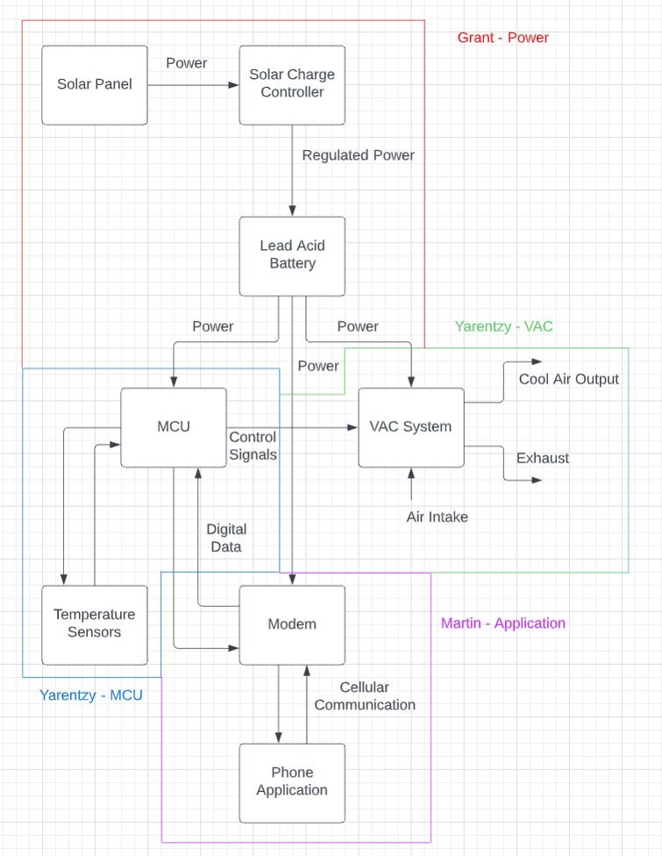
Project/Subsystem Overview

Slide 4
Major Project Changes for 404
New sponsor – Rohith Kumar
MCU Change from PIC to Arduino Mega
Redesigned both power supply step-down buck converters
Removed the second charging input from the power supply system

Slide 5
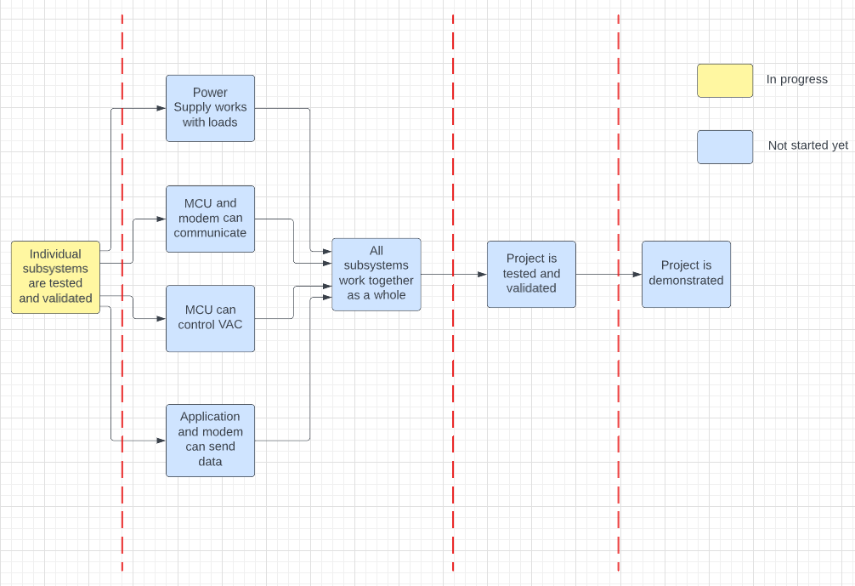

Project Timeline
8/28-9/9
9/10-10/28
10/29-11/30
12/1-12/2

Slide 6
Power Supply Subsystem
Grant Franklin
Accomplishments since 403 | Ongoing progress
Designed battery life voltage divider Designed modem buck circuit and tested on breadboard | Redesign and order parts for MCU buck circuit Test MCU buck circuit on breadboard Design and order PCB from FEDC and test circuits

Slide 7
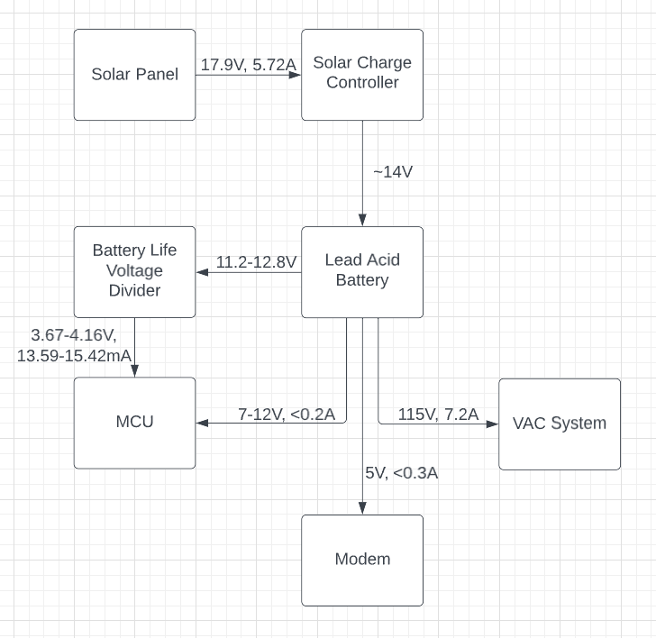
Power Supply Subsystem
Grant Franklin

Slide 8
MCU Subsystem
Yarentzy Magallanes
Accomplishments since 403 | Ongoing progress
Analog input with PIC UART with PIC Temperature readings every minute on Arduino. Temperature reading results controlling on/off status of a LED through a relay | PIC microcontroller IDE and architecture advanced Transition to Arduino Mega 2560
Notes:
Again howdy, my name is Yarentzy Magallanes and I am responsible for the microcontroller of the chilly dog. Last semester I successfully coded the PIC24 to receive analog input which would represent a reading on the battery percentage of the device, and could send and receive bits through the UART communication protocol. What I wasn’t able to do with the pic was gain functionality of the temperature sensor. The sensor I am using communicates through a single pin and requires very accurate signals in the scale of microseconds and I spent too much time attempting to get the PIC to send these signals and eventually resorted to an arduino for the demo. As a result of these issues we have decided to switch our MCU to the arduino entirely. So moving forward, I have received the Arduino and will spend this next week transferring the progress I made last semester from the PIC to the Arduino.

Slide 9


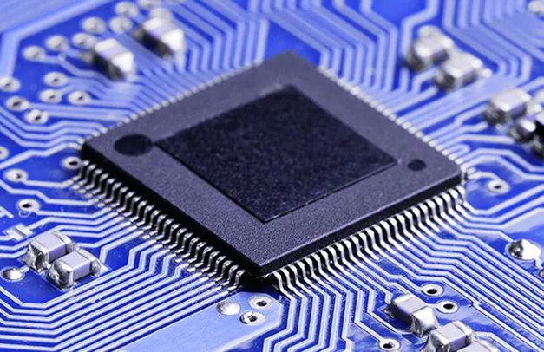






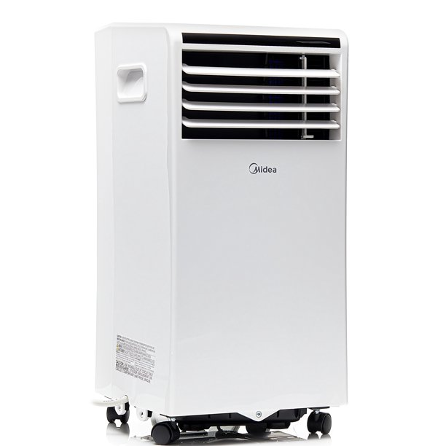
Microcontroller
MCU Subsystem
Yarentzy Magallanes
Application
Power
Setpoint
VAC
Sensor
Notes:
The microcontroller of the Chilly Dog will be the brain of the device.
It will be powered by the solar panel in our receive inputs from the power subsystem. As well as receive the percentage of the battery charge.
It will receive inputs from the ambient temperature sensor This sensor will report the internal temperature of the cabin Actively and accurately to then output that reading to the users application. The microcontroller will then receive the desired temperature set by the user on the app and output the proper air flow to meet those specifications. It will continue this process of checking the ambient temperature comparing it to the setpoint until either the desired temperature is met or the device is turned off.
For this we will be using a PIC18 for the hardware and its supporting software MPLAB.

Slide 10
VAC Subsystem
Yarentzy Magallanes
Accomplishments since 403 | Ongoing progress
Chose Model Determined placements Determined exhaust method | Establish communication with MCU and gain functionality of settings Teaming up with lecturer and PhD candidate teaching ECEN 442
Notes:
When it comes to the air conditioning unit itself I have chosen the model, Determined the best places for it to be located in the vehicle, and determined the method of exaust. This will be better illustrated in the following slide.
My next steps include establishing communication of the MCU and the air conditioning to gain functionality such as turning it on or off, as well as setting the output temperature.

Slide 11
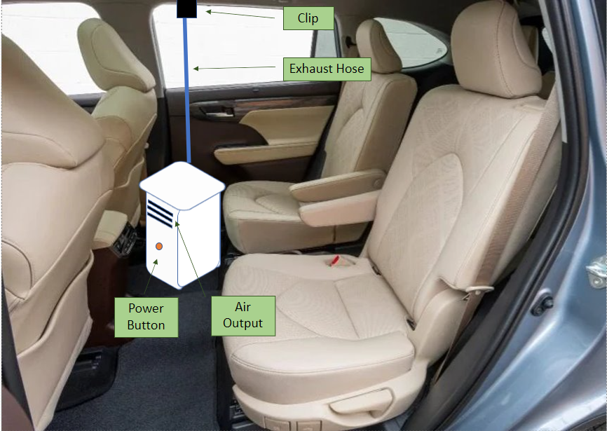
VAC Subsystem
Yarentzy Magallanes
Notes:
Floor board

Slide 12
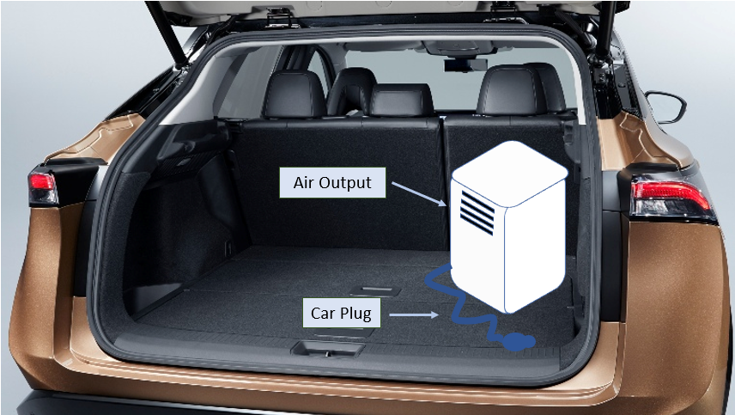
VAC Subsystem
Yarentzy Magallanes
Notes:
Trunk

Slide 13
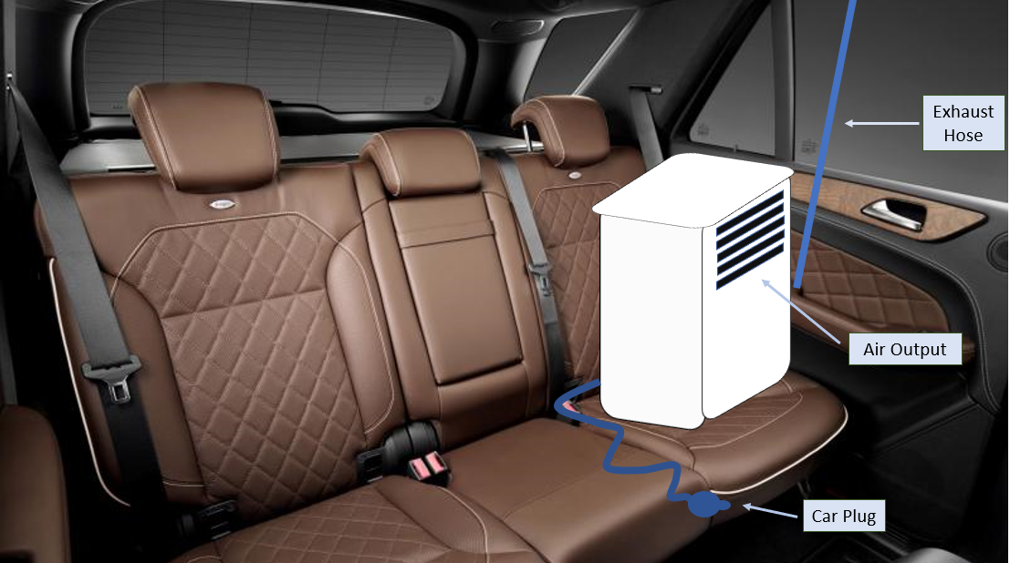
VAC Subsystem
Yarentzy Magallanes
Notes:
Seat

Slide 14
Modem/Application Subsystem
Martin Rennaker
Accomplishments since 403 | Ongoing progress
Verified that app is still functioning after the summer | Writing program to interface with modem from mcu Figure out what notifications will be sent to the user and implementing them. Make app look nicer

Slide 15
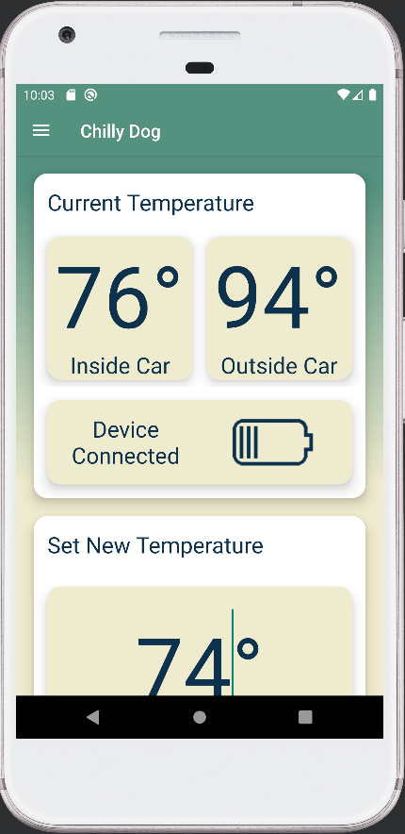
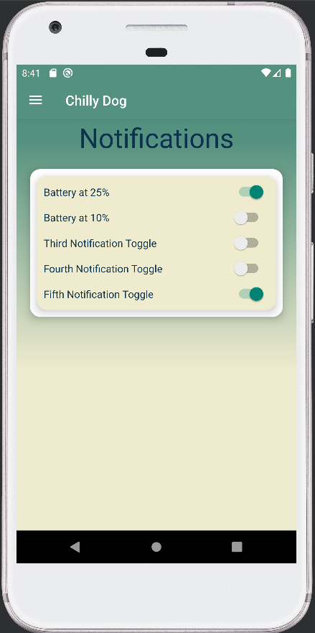
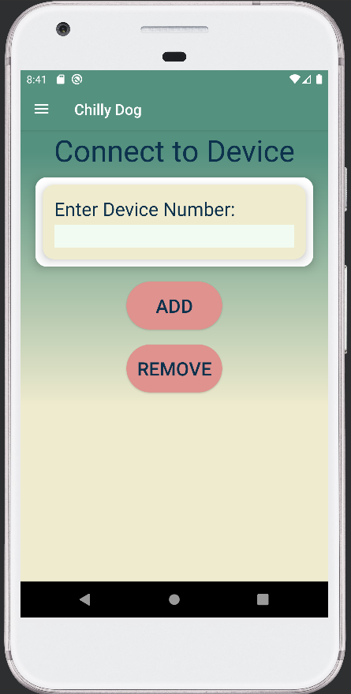
Modem/Application Subsystem
Martin Rennaker

Slide 16
Parts Ordering Status
Part Description​ | Status
5V Voltage Regulator | Part received
120uF Capacitor | Part received
100nF Capacitor | Part received
10nF Capacitor | Part received
Schottky Diode (2A) | ​Part received
22uH Inductor | ​Part received
​DHT22 Digital Temperature and Humidity Sensor | ​Order to be placed Sept 1st
Arduino Mega 2560 | Ordered and will arrive today before 8pm

Slide 17
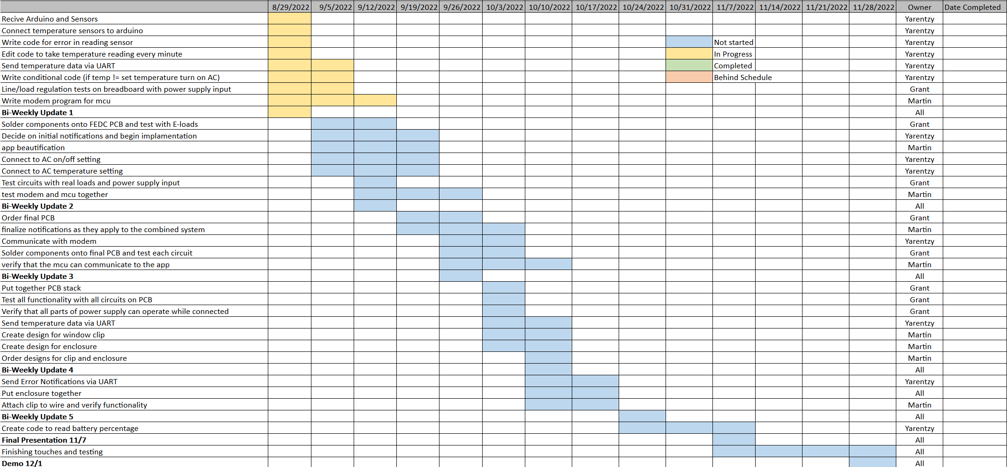
Execution

Slide 18
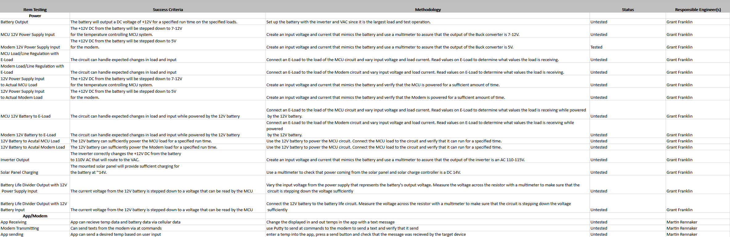
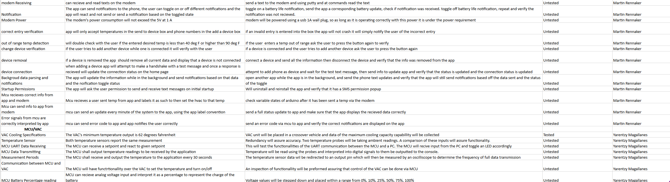
Validation

Slide 19
Thank You!
Questions?

